Slide 1


PRESENTED BY
Shanmukha Rao Sahukari
Skill Forge – Milestone 2 Presentation
Backend Module Developed by: Shanmukha Rao Sahukari Tech Stack: HTML, CSS, JavaScript, Node.js, Express.js, MySQL Date: 14 December 2025

Slide 2
TABLE OF CONTENTS
Project Overview
Product Backlog (Sprint 1)
Sprint Backlog Summary
Milestone 2 Summary
Backend Foundadtion
Backend Architecture
MYSQL Database Design
Authentication & JWT Security
Role-Based Access Control (RBAC)
Postman Testing (Milestone 2)
Postman Testing: Protected Route
Postman Testing: Register API
Postman Testing: Login API
Login Page
Register Page
Landing Page
Conclusion

Slide 3

Project Overview
What is SkillForge?
SkillForge is a full-stack e-learning platform designed to provide a seamless learning experience with course browsing, user authentication, dashboards, and future AI-powered features.
Milestone 2 Focus
✔ Authentication Module ✔ Database Setup ✔ UI (Login & Registration) ✔ API Development ✔ Postman Testing ✔ Documentation & GitHub

Slide 4

Product Backlog (Sprint 1)
Key Backlog Items
User Registration Module
User Login Module
Password Encryption (bcrypt)
JWT-based Authentication (Security)
Protected Route (/me)
Frontend Login Page
Frontend Register Page
Frontend Admin Page
MySQL Database Setup
API Testing (Postman)(Role-based APIs)
Documentation & GitHub Commit

Slide 5

Sprint Backlog Summary
Completed Sprint Tasks
Project folder structure setup
MySQL database & table creation
Register API backend implementation
Login API backend implementation
JWT Middleware creation
Frontend UI design (Login & Register)
Integration of frontend with backend
Postman testing
GitHub repository setup
Requirement & backlog documentation

Slide 6
Milestone 2 Summary
SkillForge is a role-based learning platform that enables:
Secure user authentication
Admin-controlled course management
Instructor-led course & assignment creation
Scalable backend architecture for AI features
Focus of these milestones:
Backend foundation
Security
Role-based APIs

Slide 7

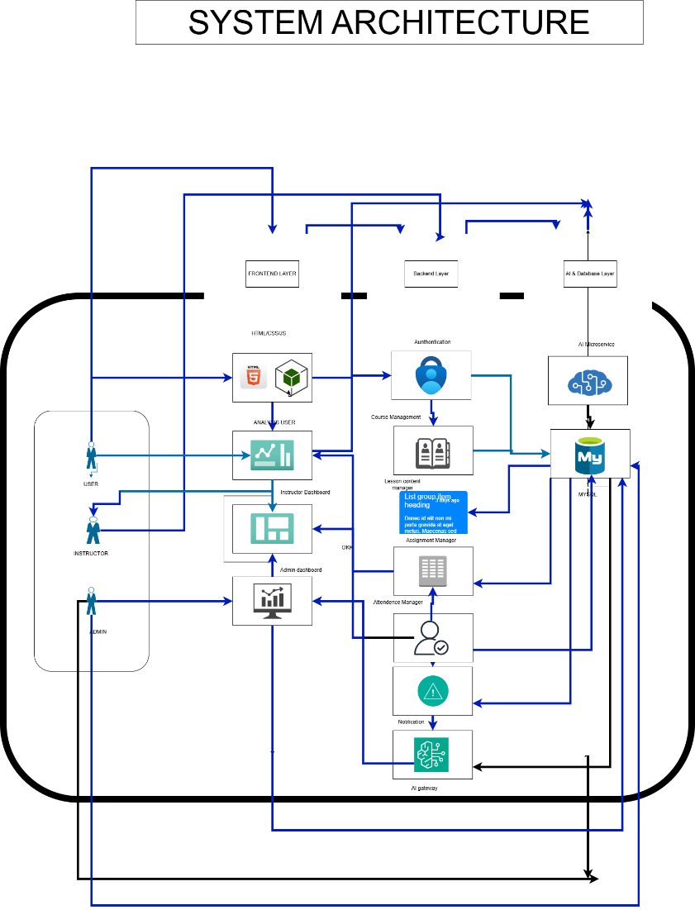
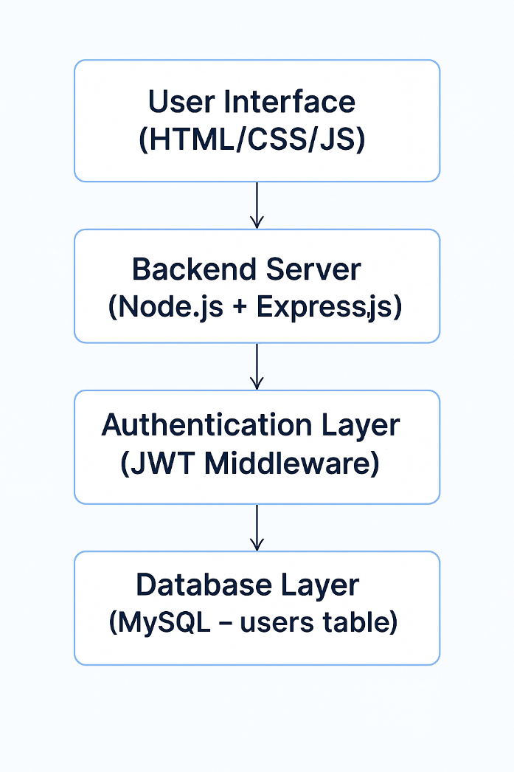
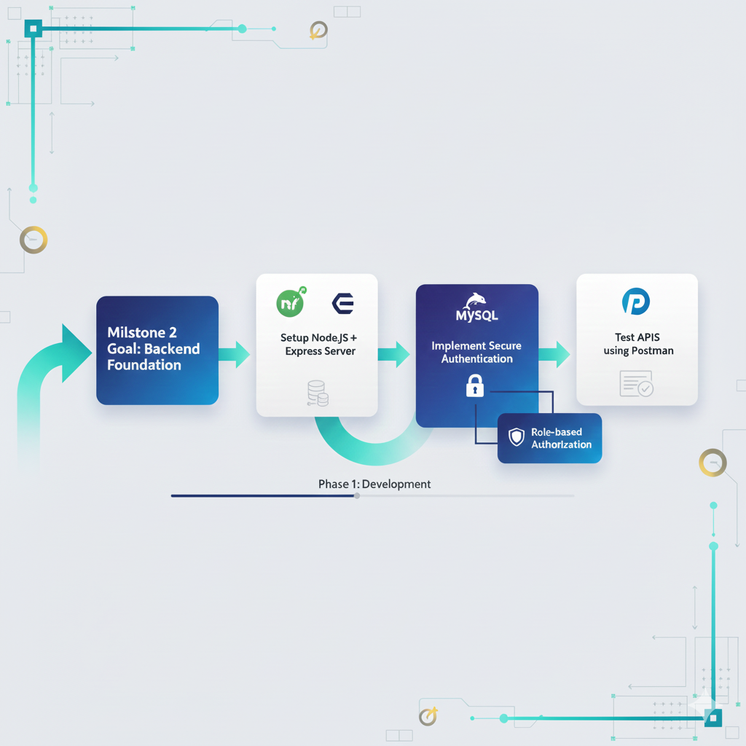
Architecture Diagram
Milestone 2 Summary
Milestone 2 Goal: Backend Foundation
Setup Node.js + Express server
Connect MySQL database
Implement secure authentication
Role-based authorization
Test APIs using Postman
7

Slide 8
Backend Architecture (Milestone 2)
Server Architecture:
Express.js REST API
MySQL database
Modular route structure
Centralized DB access using:
“ app.set("db", db) “
Middleware Used:
CORS
JSON body parser
JWT authentication middleware

Slide 9

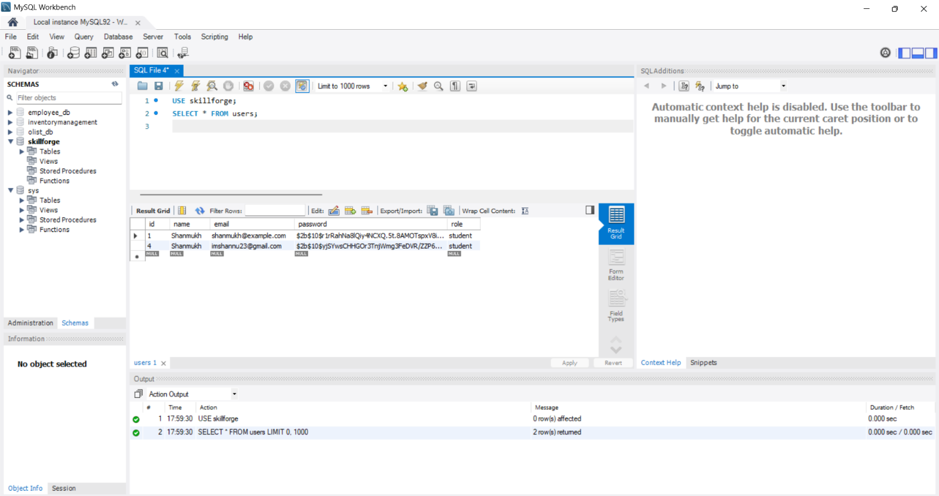
Database Design (Milestone 2)
Core Tables Created
users
id, name, email, password, role
courses
id, title, description, instructor_id, category, level, image
Key Concepts
Role stored at DB level
Foreign key relationships
Scalable for future features
Field | Type | Description
id | INT (PK, Auto Increment) | Unique user ID
name | VARCHAR | Username
email | VARCHAR (Unique) | Login email
password | VARCHAR | Hashed password

Slide 10
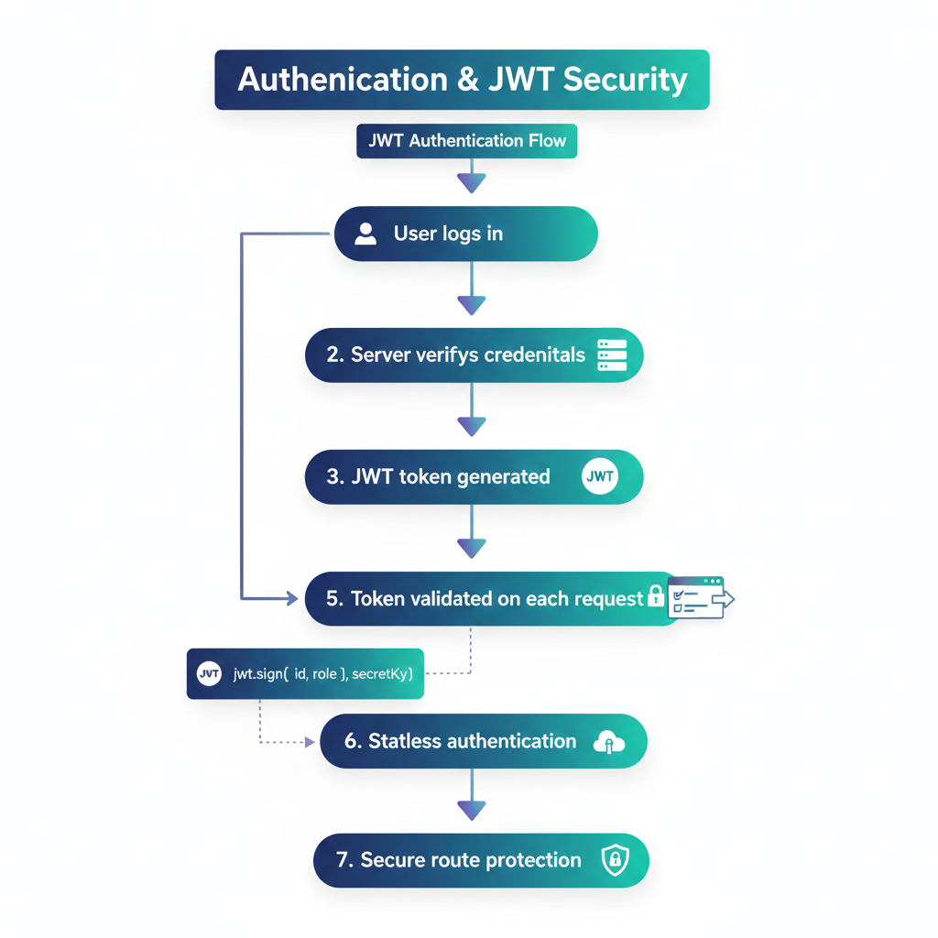
Authentication & JWT Security
JWT Authentication Flow
User logs in
Server verifies credentials
JWT token generated
Token sent to frontend
Token validated on each request
“ jwt.sign({ id, role }, secretKey) “
✔ Stateless authentication ✔ Secure route protection

Slide 11
Role-Based Access Control (RBAC)
Access Control Rules
User logs in
Admin → Full access
Instructor → Course & assignment management
Student → Limited access (future scope)
Example:
“ if (req.user.role !== "admin") return 403; “
✔ Prevents unauthorized actions ✔ Enforced on backend level

Slide 12
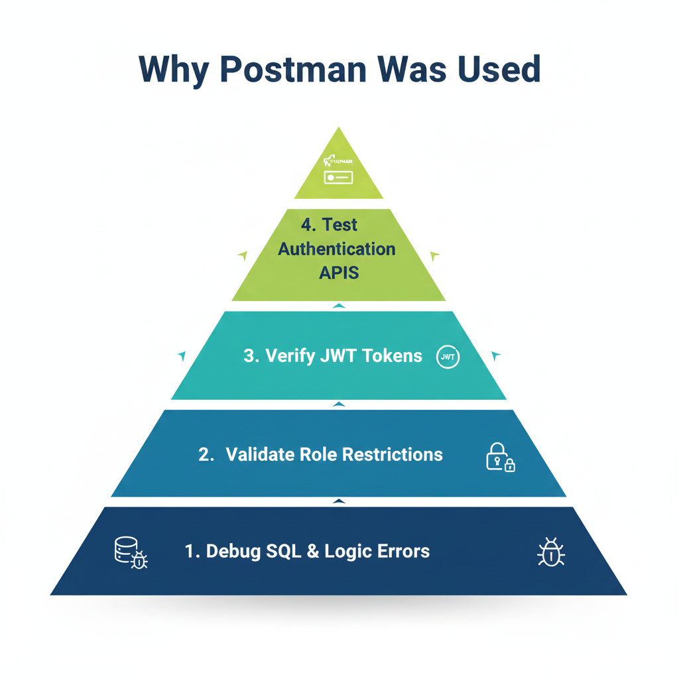
Postman Testing (Milestone 2)
Why Postman Was Used
Test authentication APIs
Verify JWT tokens
Validate role restrictions
Debug SQL & logic errors
APIs Tested:
✔ /register
✔ /login
✔ /me
📌 Postman used only for development & testing

Slide 13
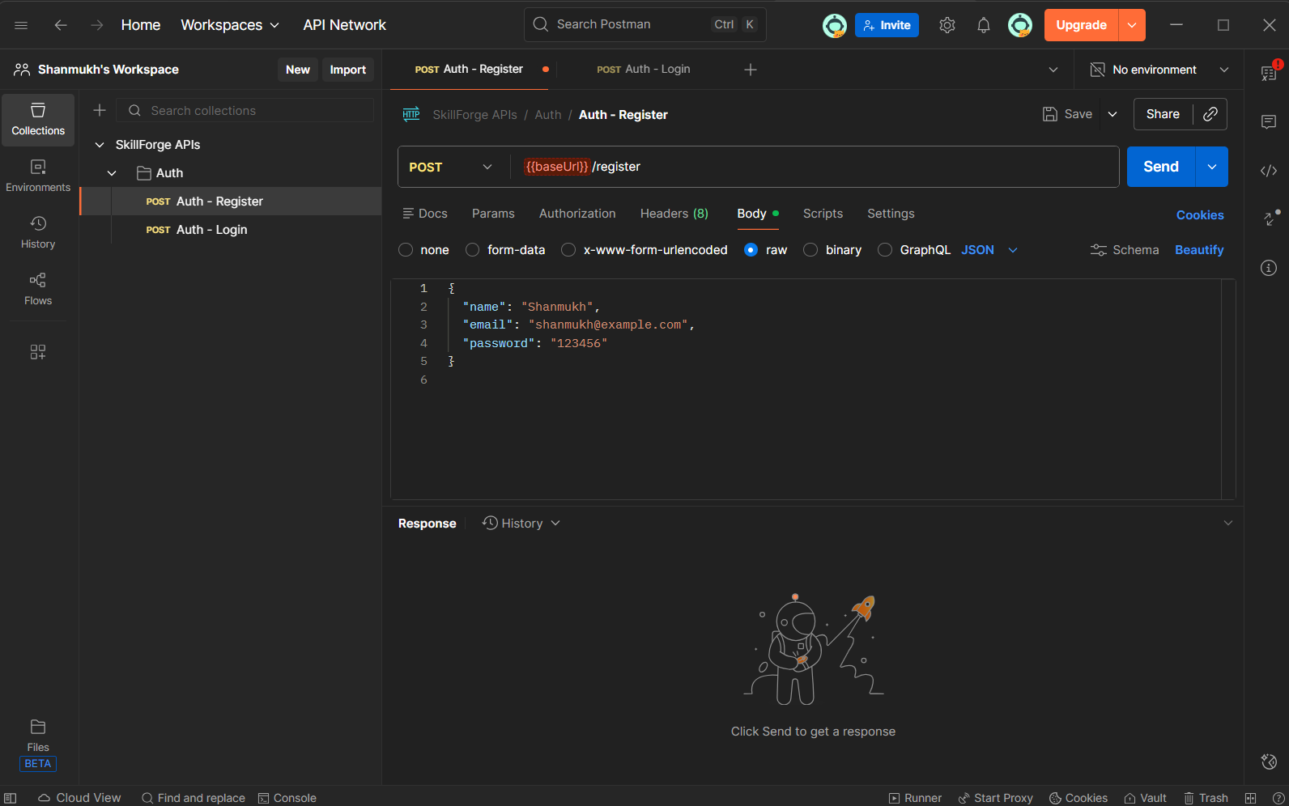
Postman Testing: Register API
Register API Test
Endpoint: POST /register
Purpose: Create new user
Tested with valid and invalid data
Stored in MySQL successfully

Slide 14
Postman Testing: Login API
Login API Test
Endpoint: POST /login
Verifies email & password
Returns JWT token + user info
Error handled: User not found, wrong password

Slide 15
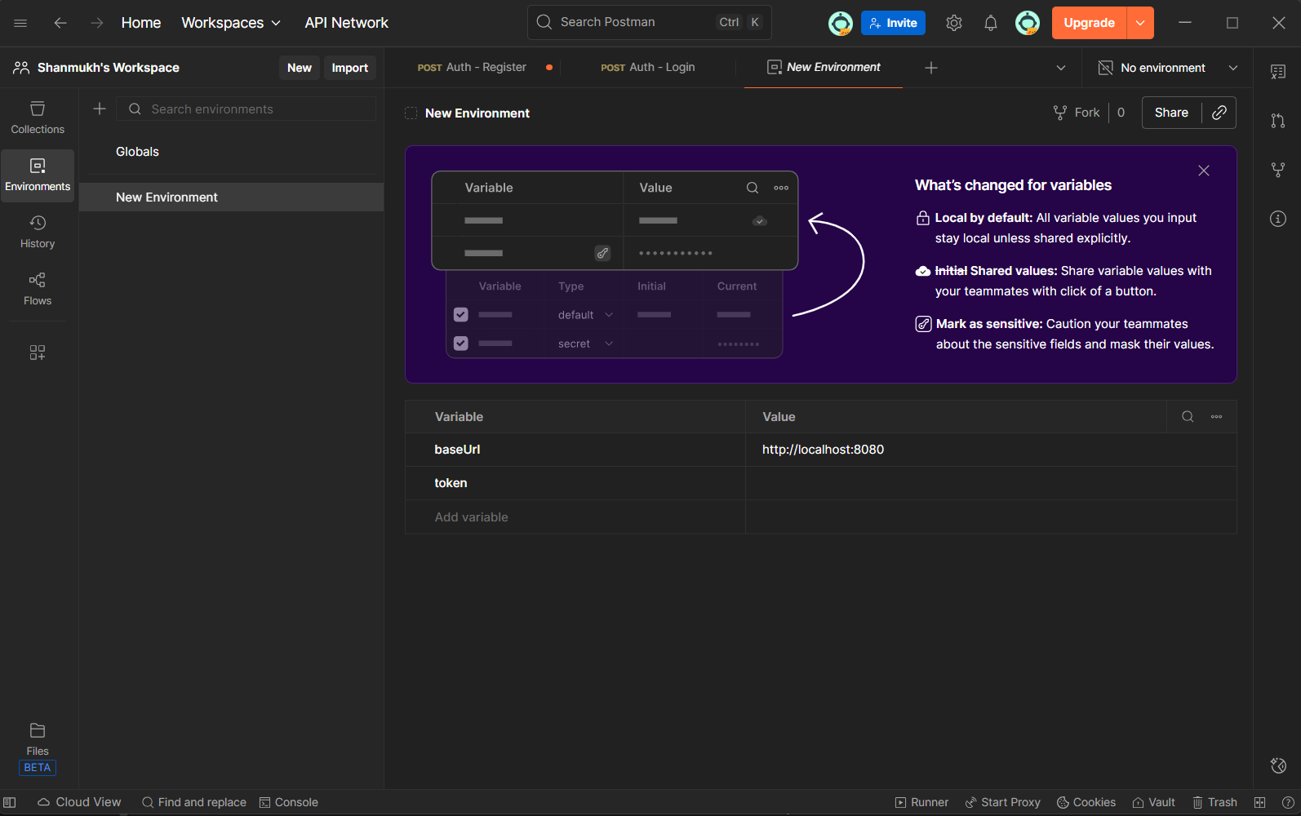
Postman Testing: Protected Route
Protected Route: /me
Requires Authorization: Bearer <token>
Returns authenticated user details
Ensures JWT security

Slide 16
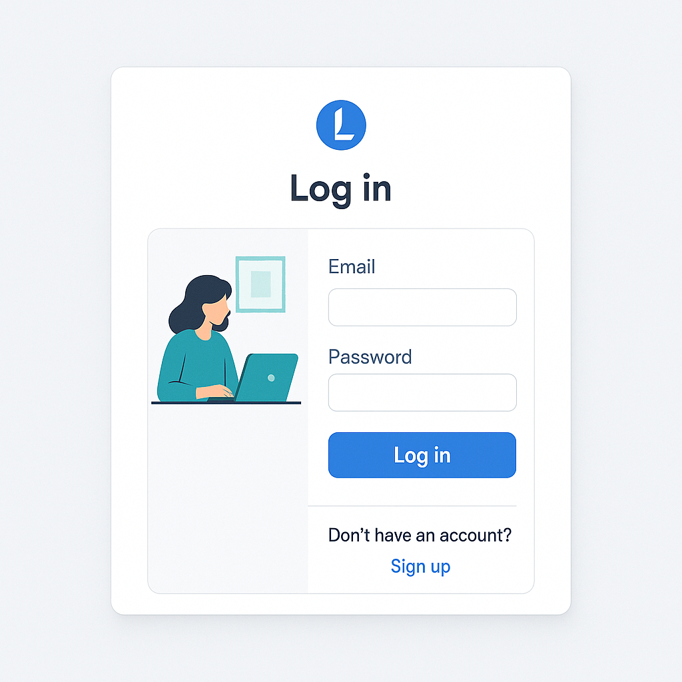
(Login Page)
Login Page Features
Clean user interface
Email and password input fields
Error handling for invalid credentials
Integrated with backend login API

Slide 17
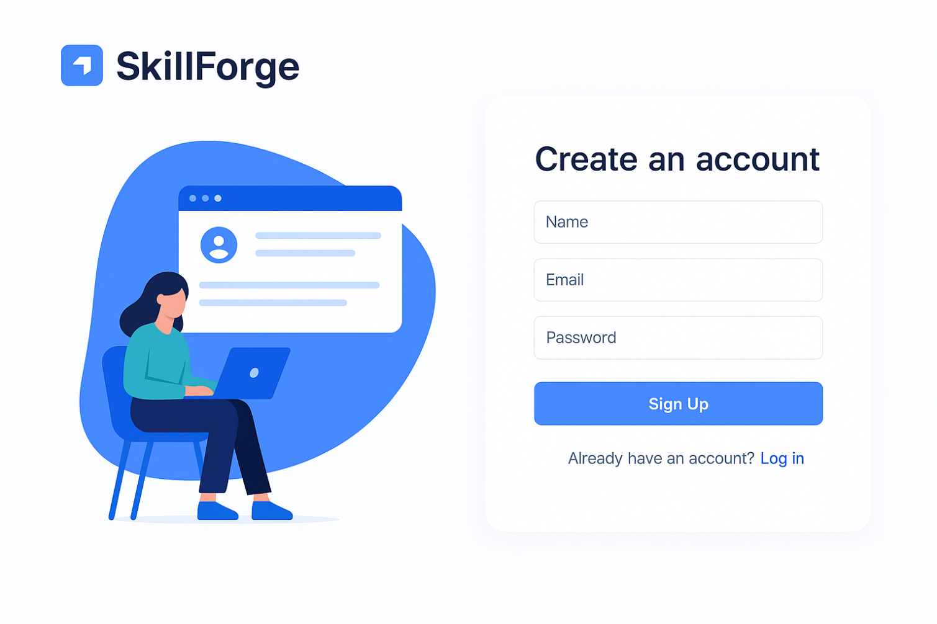
(Register Page)
Register Page Features
Name, email, password fields
Input validation
Connected to backend register API
Auto-redirect after successful signup

Slide 18
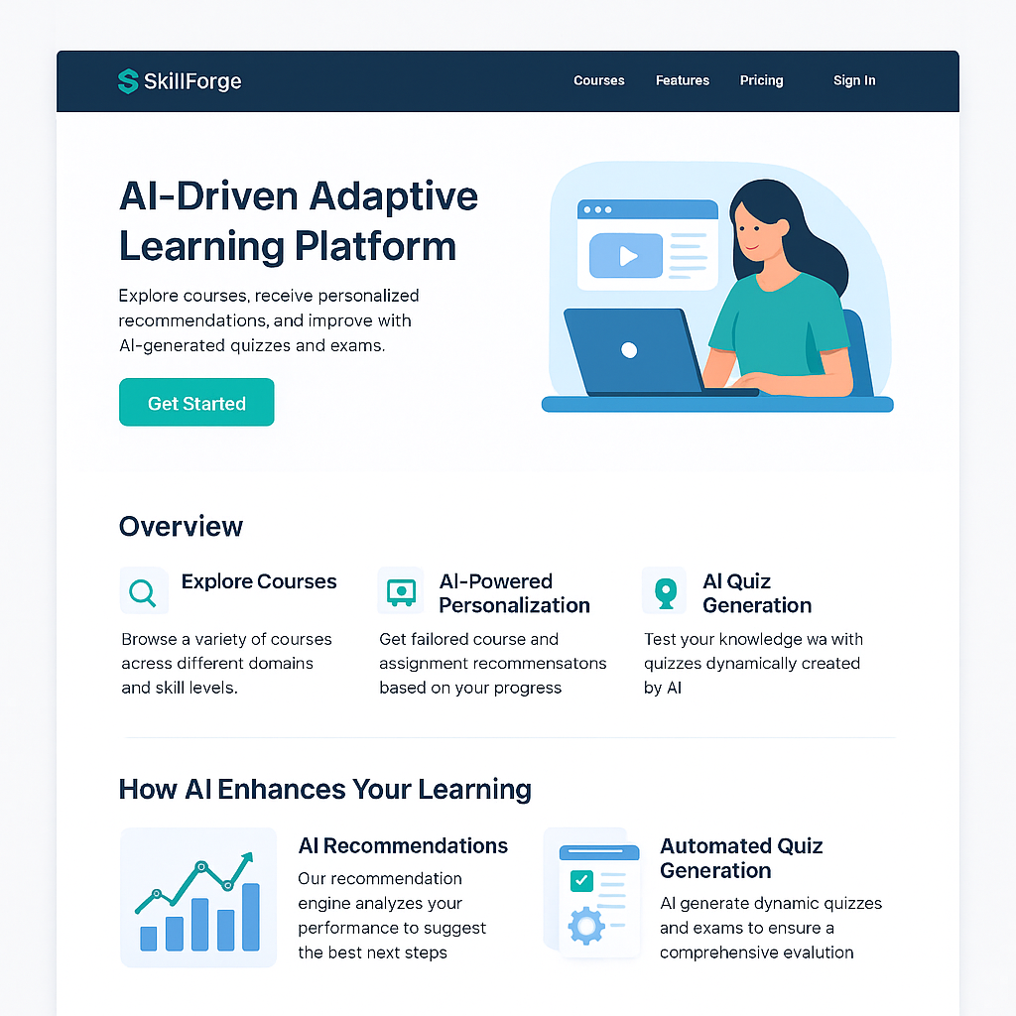
Landing Page
What the Landing Page Represents:
The landing page is the first point of interaction for users on the SkillForge learning platform. It communicates the platform’s purpose, key features, and encourages users to sign up or log in.

Slide 19

Conclusion
✔ Milestone 2 Completed Successfully
Authentication module fully implemented
Backend tested using Postman
Frontend integrated with backend APIs
Project structured and documented
Ready for Milestone 3 (Dashboard, Courses Module, etc.)

Slide 20

THANK YOU

